Slide 1
LTL Generator
Elvijs Ostrovskis
Jennifer Weand
Oscar Diaz
Jose Macias
Robert Fierro
Juan Ochoa

Slide 2
CRC Diagram
Elvijs Ostrovskis

Slide 3
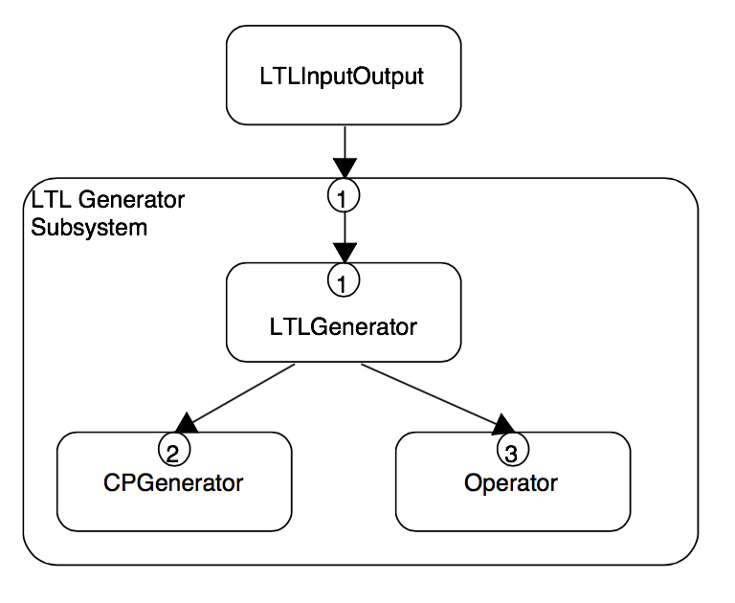
LTL Input/Output and LTL Generator

Slide 4
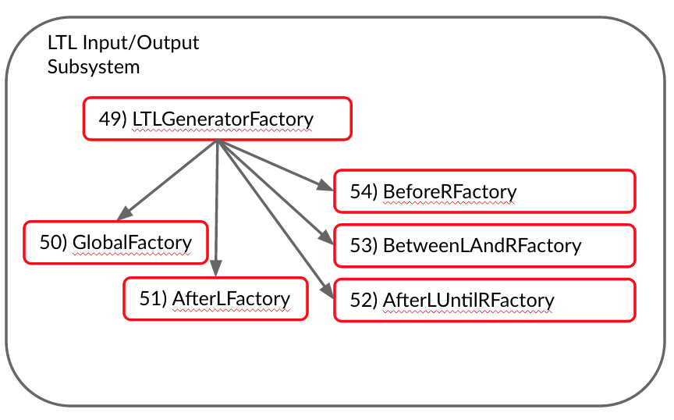
LTL Input/Output and LTL Generator
LTL Input/Output
Subsystem
49) LTLGeneratorFactory
54) BeforeRFactory
50) GlobalFactory
53) BetweenLAndRFactory
51) AfterLFactory
52) AfterLUntilRFactory

Slide 5
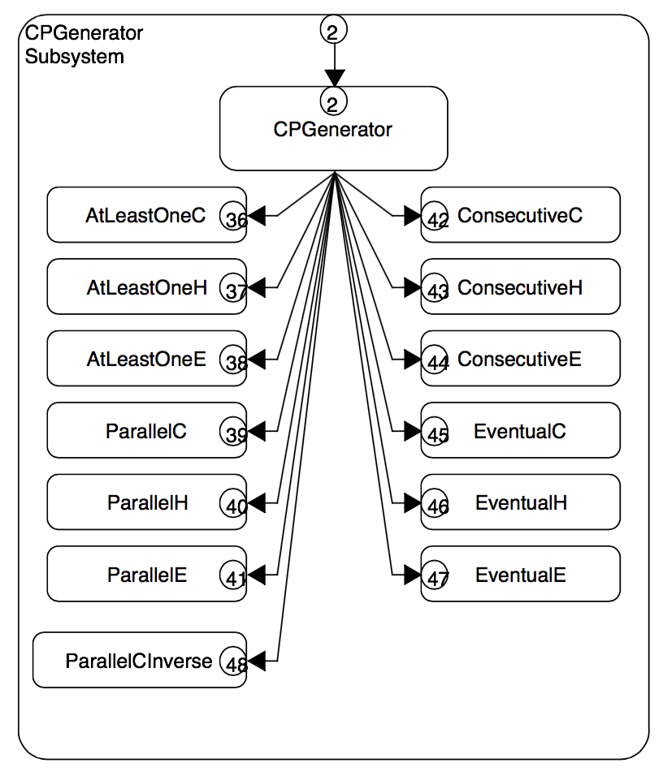

Composite Proposition Generator

Slide 6
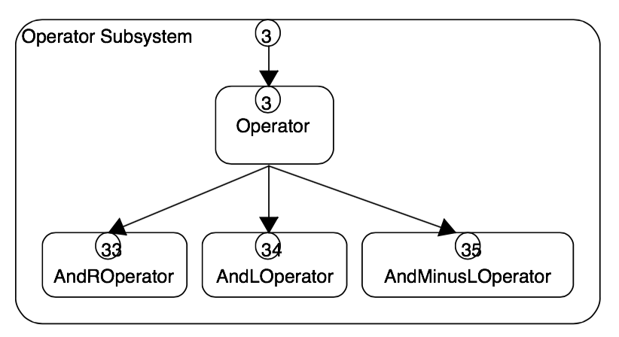
Operator
(55) AndLForBeforeR

Slide 7
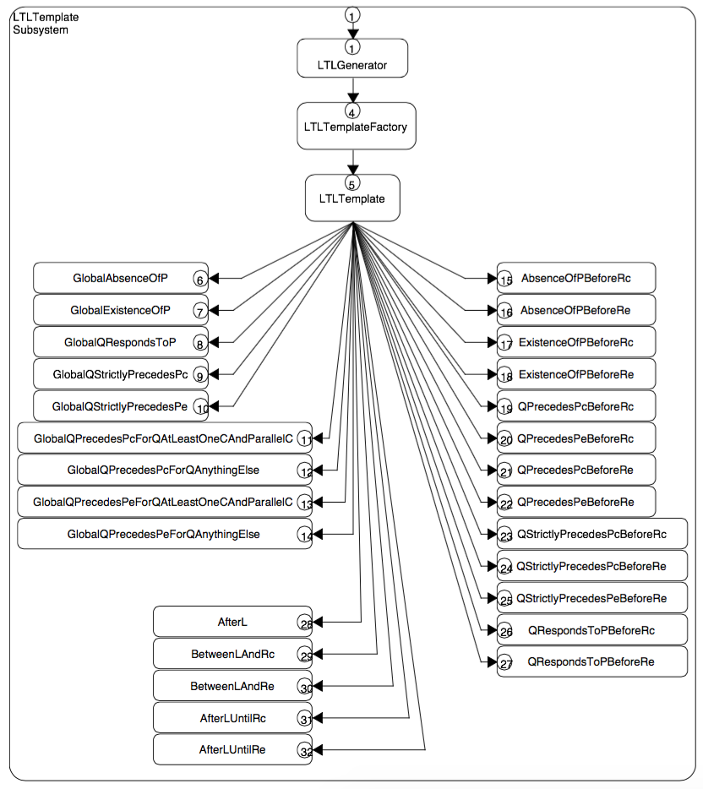
LTL Template

Slide 8
Elvijs' Contributions
To The Project

Slide 9
Grunt Work
added logic for many classes
kept our Git repository up-to-date
taught teammates how to use Github (how to fork repository, how to make pull requests)

Slide 10
Composite Propositions
- Consecutive H
- Eventual C
- Eventual E
- Eventual H
(- test cases for these classes)

Slide 11
Global Template
- Global Q Precedes PE * (reworked)
- Global Q Precedes PC * (edited)
- Global Q Precedes PE + (edited)
- Global Q Strictly Precedes PC (edited)
- Global Q Strictly Precedes PE (edited)
(- test cases for these classes (updated))

Slide 12
Before R Template
- Q Strictly Precedes Pc Before Rc
- Q Strictly Precedes Pe Before Rc
- Q Strictly Precedes Pc Before Re
- Q Strictly Precedes Pe Before Re
(- test cases for these classes)

Slide 13
Between L and R & After L until Rc
- Between L and Rc
- Between L and Re
- After L until Rc
(- test cases for these classes)
- Template Factory

